Slide 1
Department of Career Planning & Development
BE-CSE – 6th Semester
SYSTEM DESIGN
(23CSH-314/23ITH-314)
UNIT 01 – CHAPTER 01
ALOK KUMAR – ASSISTANT PROFESSOR & KARGIL TECHINCAL TRAINER (DCPD)
EMAIL: DCPD.KARGILT1@CUMAIL.IN

Slide 2
CONTENTS – CHAPTER 01
1. System Design basics
2. High-Level Design (HLD) vs Low-Level Design (LLD)
3. Functional vs Non-functional Requirements
4. Latency
5. Throughput
6. QPS
7. Availability
8. Scaling challenges.

Slide 3
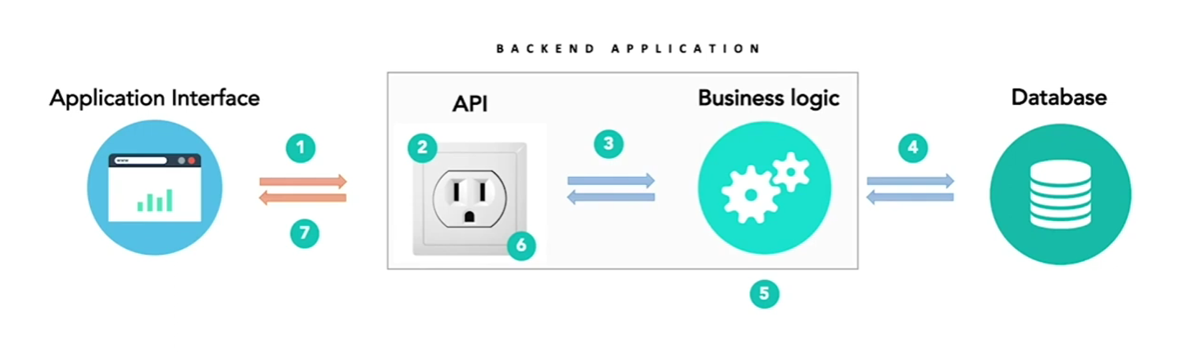
Communication – FE, BE & API’s

Slide 4
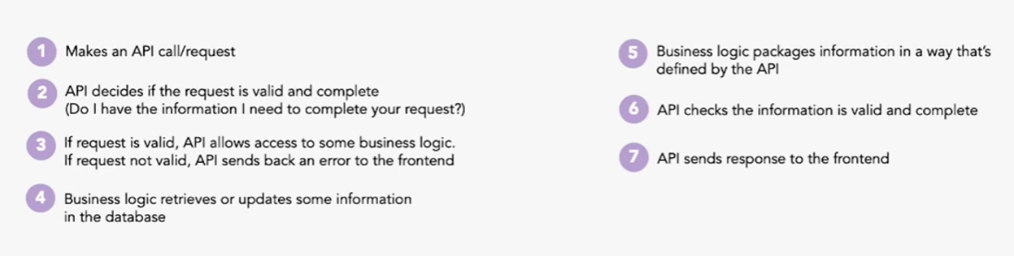
Communication – FE, BE & API’s

Slide 5
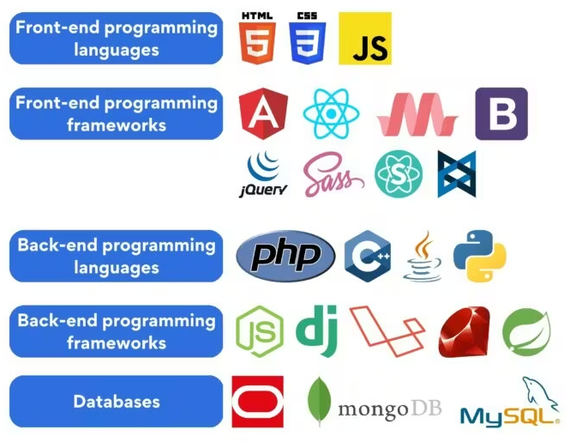
Tech-Stack

Slide 6
Fundamentals – System Design
Before understanding System Design, you must understand what a system is.
A system is a collection of multiple components that:
Work together
Interact with each other
Achieve a common goal
Examples of Systems
Railway Reservation System
E-commerce Platform (Amazon)
Banking System
Hospital Management System
Each of these systems:
Has users
Has data
Has rules
Has workflows

Slide 7
Fundamentals – System Design
What is System Design?
System Design is the process of defining the architecture, components, interfaces, data flow, and technologies of a software system to satisfy both functional and non-functional requirements.
Why Do We Need System Design? (E-Commerce Platform)
Imagine:
You directly start coding Amazon-like app
No planning
No architecture
With System Design
You decide in advance:
How users will login
How orders will be processed
How database will be structured
How system will handle millions of users
Problems:
System becomes slow
Code becomes unmanageable
Scaling becomes impossible
Frequent failures

Slide 8
Fundamentals – System Design
System Design Asks Questions Like
For E-commerce App:
How many backend servers do we need?
Should we use one database or multiple?
Where should authentication happen?
How fast should product search be?
How do we handle sale traffic (Big Billion Days)?
System Design is about planning before building

Slide 9
Fundamentals – System Design
What Does System Design Include?
Architecture
Components
Data Flow
Communication
Scalability & performance
Reliability & security
System Design vs Coding
Aspect | Coding | System Design
Focus | Logic | Architecture
Scope | Small | Large
Scale | Single Module | Entire System
Concern | Correctness | Consistency, Availability & Reliability

Slide 10
Fundamentals – System Design
System Design is the process of planning and defining the architecture, components, data flow, and interactions of a software system so that it meets functional and non-functional requirements such as scalability, performance, and reliability. System design focuses on how the complete system works together, not just how individual code modules are written.
Key Insight: System design is about architecting solutions for real-world challenges at scale, not just writing code.
Example: Google Search distributes queries across thousands of servers, processes them in parallel, and returns results in milliseconds. This efficiency is a direct result of strong system design.

Slide 11
Purpose – System Design
Modern software systems must handle:
Millions of users
Large volumes of data
Continuous availability (24×7 systems)
Hardware and software failures
Without proper system design:
Applications become slow
Systems crash under load
Maintenance cost increases
Real-World Example:
Applications like Google Search or Netflix work smoothly because their systems are designed to scale and handle failures gracefully.
Case Study on Facebook’s System Outages
Link : https://techcrunch.com/2019/03/14/facebook-blames-a-misconfigured-server-for-yesterdays-outage/

Slide 12
Why – System Design ?
Example: Online Examination System
During online exams:
Thousands of students log in at the same time
All students submit answers simultaneously
Results must be stored safely
Without proper system design:
Website may crash
Answers may not be saved
Students may lose attempts
This shows why system design is critical.

Slide 13
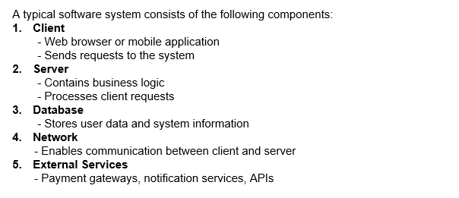
Core Components of a Software System

Slide 14
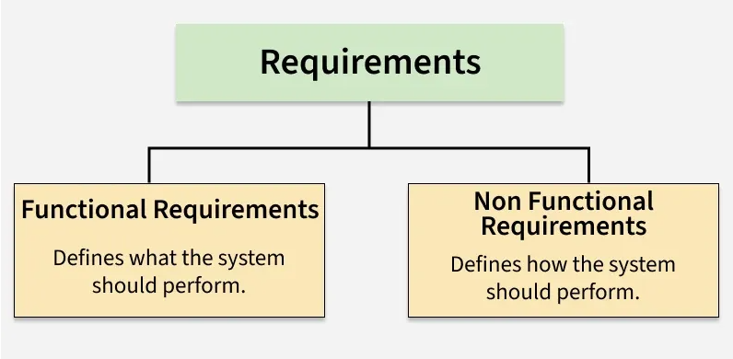
Requirements – Functional & Non-Functional
Requirements describe what a system should do and how well it should perform.
In Simple Terms
Requirements answer two questions:
What should the system do?
How should the system behave?
Example (E-commerce)
User should be able to search products
Order placement should be fast
System should not crash during sales

Slide 15
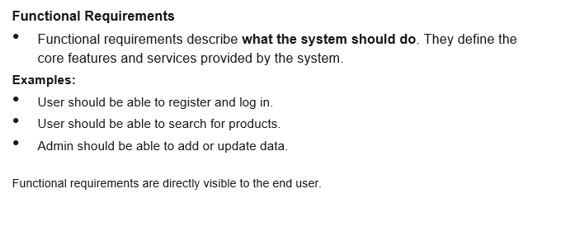
Requirements – Functional & Non-Functional

Slide 16
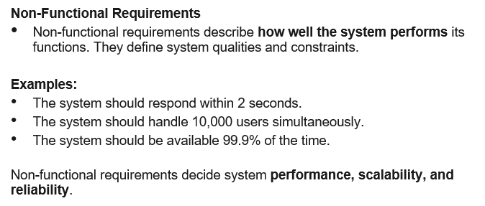
Requirements – Functional & Non-Functional

Slide 17
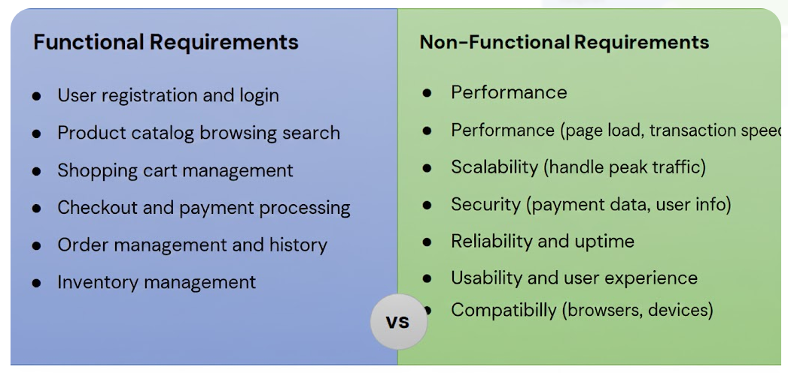
Functional & Non-Functional - Ecommerce

Slide 18
Designing – HLD vs LLD
Now that we clearly understand what the system should do (FRs) and how well it should perform (NFRs), the next step is to design the system.
Design happens in two layers:
High-Level Design (HLD)
Low-Level Design (LLD)

Slide 19
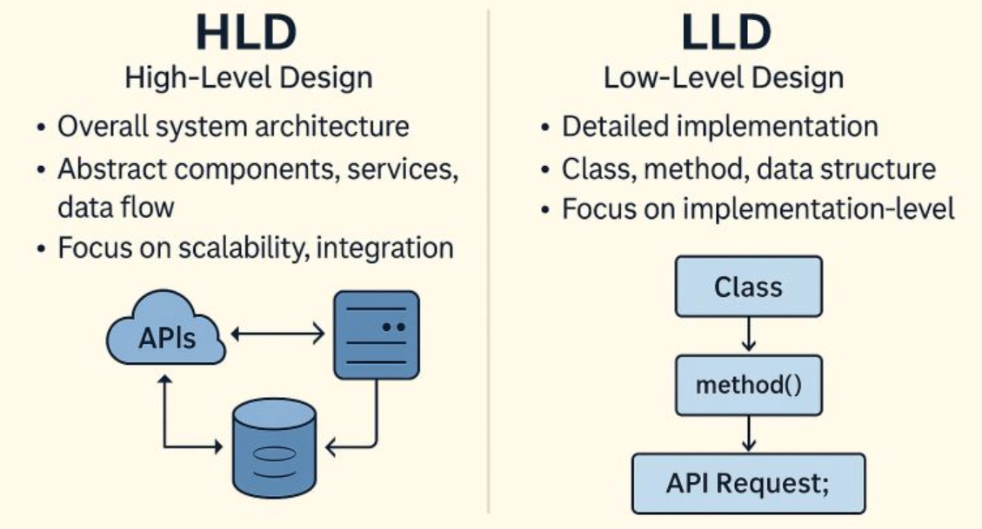
Designing – HLD vs LLD

Slide 20
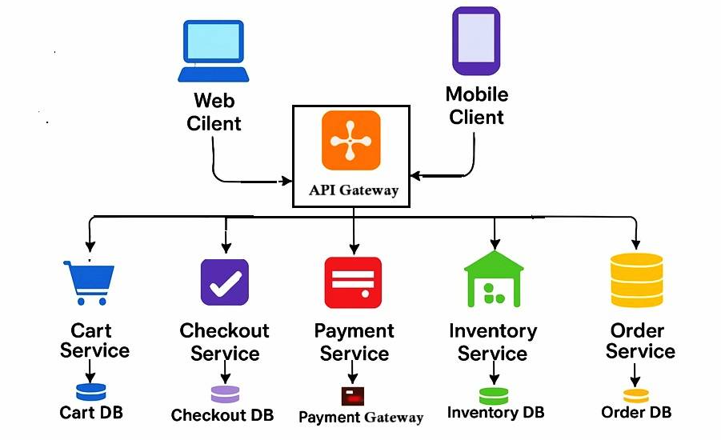
HLD – eCommerce Platform (Basic)

Slide 21
Diagrams we use to build LLD
In High-Level Design, we focus on:
Actors (users)
System boundaries
High-level flow
Component interaction (not classes & methods)
Common Diagrams Used:
1. Use case diagram – Shows system functionality
2. Sequence diagram – Shows request floe
3. Activity diagram – Shows workflow
4. Component diagram – Shows system component interaction

Slide 22
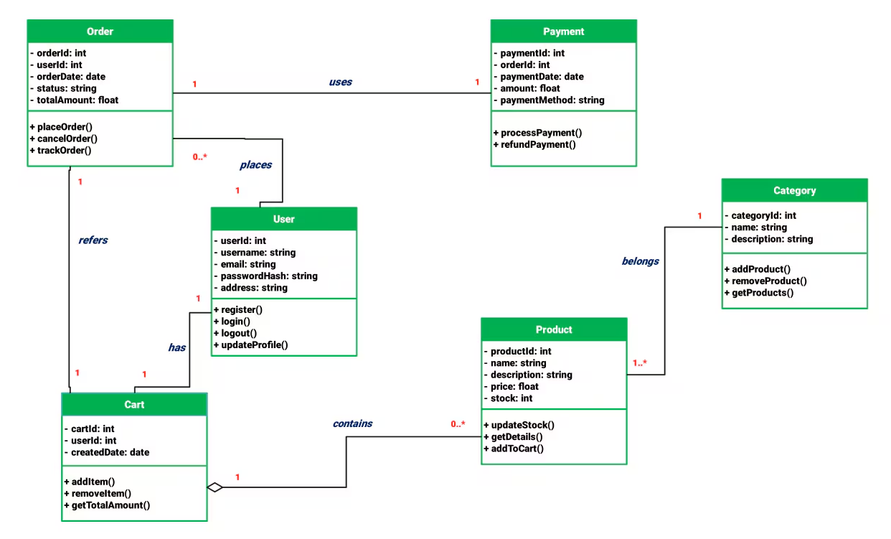
LLD – eCommerce Platform (Basic)

Slide 23
Diagrams we use to build LLD
Diagram Name | Description
Class Diagram | Shows classes, their attributes, methods, and relationships; used as a blueprint for coding.
Sequence Diagram | Illustrates the order of interactions (method calls/messages) between objects over time.
State Machine Diagram | Represents different states of an object and transitions between them based on events.
Activity Diagram | Depicts the step-by-step workflow or business logic with decisions and parallel flows.
Object Diagram | Shows actual instances of classes and their relationships at a particular moment in runtime.

Slide 24
Key Performance Metrics in System Design
Even if a system is functionally correct, it is useless if it is slow, unavailable, or cannot handle traffic
Performance metrics help system designers evaluate how well a system behaves under real-world conditions.
These metrics are critical for designing scalable, reliable, and efficient systems.
Commonly used performance metrics include:
Latency
Throughput
Queries Per Second (QPS)
Availability

Slide 25
Key Performance Metrics in System Design
Latency
Latency is the time taken for a system to respond to a request.
Simple Terms: How long does a user wait after clicking a button?
It measures the delay between:
A request sent by the user
The response received from the system
Latency is usually measured in milliseconds (ms).
Examples:
Time taken to load a web page
Time for an API to return data
Low latency is important for:
User experience
Real-time systems (chat apps, online gaming, trading systems)
Industry fact:
Amazon observed that 100 ms increase in latency can reduce sales.

Slide 26
Key Performance Metrics in System Design
Types of Latency
Latency can occur at different levels:
Network latency – delay in data transmission over the network
Application latency – time taken by application logic
Database latency – time for database queries to execute
Total system latency is the sum of all these delays.
How Designers Reduce Latency
Caching product data
Using CDNs for images
Optimized database queries

Slide 27
Key Performance Metrics in System Design
Throughput
Throughput refers to the number of requests a system can process in a given time.
It answers the question:
How much work can the system handle?
Measured as:
Requests per second
Transactions per second
High throughput is required for:
Large-scale systems
Systems with many concurrent users
Example:
A payment system processing 10,000 transactions per second
Throughput: 10,000 transactions/sec

Slide 28
Key Performance Metrics in System Design
Latency vs Throughput
Latency and throughput are related but different:
Latency focuses on speed of response
Throughput focuses on capacity of the system
A system can have:
Low latency but low throughput
High throughput but higher latency
Good system design balances both metrics based on requirements.

Slide 29
Key Performance Metrics in System Design
Queries Per Second (QPS)
Queries Per Second (QPS) measures how many queries or requests a system can handle every second.
Simple terms: How many users are hitting the system at the same time?
It is commonly used for:
APIs
Databases
Search systems
QPS helps designers understand:
Load handling capability
Peak traffic limits
Example:
A search engine handling 50,000 queries per second

Slide 30
Key Performance Metrics in System Design
Queries Per Second (QPS)
Example:
Scenario:
60,000 users visit the site per minute
QPS = 60,000 / 60 = 1,000 QPS
➡ System must handle 1,000 requests per second
Why QPS Is Critical in Design
Helps decide:
  Number of servers
  DB capacity
  Cache usage
Read vs Write QPS
In E-commerce:
Read QPS (higher)
  Browse products
  View product details
Write QPS (lower)
  Place orders
  Make payments

Slide 31
Key Performance Metrics in System Design
Importance of QPS in System Design
QPS is used to:
Estimate server capacity
Design load balancers
Decide database scaling strategies
High QPS systems often require:
Horizontal scaling
Caching
Efficient indexing
QPS Optimization Techniques
Read replicas for databases
Caching popular product pages
Rate limiting to protect backend

Slide 32
Key Performance Metrics in System Design
Availability
Availability measures how often a system is operational and accessible.
It is usually expressed as a percentage.
Formula:
Availability = (Uptime / Total Time) × 100
Example:
99.9% availability allows about 8.7 hours of downtime per year

Slide 33
Key Performance Metrics in System Design
Availability Levels (Service Level Agreement Example)
In system design, SLA answers:
“What level of performance are we promising?”
Common availability targets:
99% – basic systems
99.9% – most production systems
99.99% – critical systems
99.999% – highly reliable systems (banking, healthcare)
Higher availability requires:
Redundancy
Failover mechanisms
Monitoring and alerting
Real Example
During a sale, website crashes for 2 hours
SLA violated → business loss + penalties
Design Impact
To meet this SLA, system must use:
Load balancers
Multiple servers
Database replication

Slide 34
Applications
Application 1: E-Commerce (Latency & Availability)
  User adds item to cart. Low latency is required for UI responsiveness. High availability (99.99%) ensures no revenue loss during sales.
Application 2: Twitter/Social Media (Read-Heavy QPS)
  200M users, read-heavy traffic. Uses Caching (Redis) for 90% of requests and Read Replicas for databases.
Application 3: IoT Telemetry (Write-Heavy QPS)
  Millions of sensors. Uses Batching and Message Queues (Kafka) to handle massive write throughput.
Application 4: Streaming Services (Scaling)
  Uses CDNs to solve network bottlenecks and horizontal scaling to handle concurrent user surges.

Slide 35
Scalability
While running an E-commerce website.
Problems Observed
Product pages load slowly
Checkout requests time out
Database CPU hits 100%
Server crashes
Initial Situation
1 backend server
1 database
500–1,000 daily users
Everything works fine:
Pages load fast
Orders are placed successfully
No complaints
Root Cause
The system was never designed to handle this load.
Here comes the scalability factor
You announce a Flash Sale.
Now:
50,000 users come within 10 minutes
Everyone opens product pages
Thousands try to checkout simultaneously
What Is Scalability?
Scalability is the ability of a system to handle increasing workload by adding resources, without degrading performance.

Slide 36
Scalability
A scalable system can:
Support a growing number of users
Process more requests
Manage increasing amounts of data
without system failure or slowdown
In simple terms:
Scalability means the system grows smoothly as demand increases.
OR
Can my system grow when users grow?
Non-Scalable System
1 server handles max 1,000 users (Kind of Monolithic architecture)
10,000 users come
System crashes
Scalable System
Add more servers (Kind of distributed architecture)
Load is distributed
System keeps working

Slide 37
Scalability
Modern applications grow very fast. A system that works well today may fail tomorrow if it is not scalable.
Scalability is important because:
User traffic increases over time
Business expands to new regions
Data volume grows continuously
Peak usage occurs during special events
Without scalability:
Response time becomes slow
Servers crash under heavy load
Users face service disruption

Slide 38
Scalability
Example: Online Ticket Booking System
On normal days: few hundred users
On festival days: millions of users
If the system is scalable:
It handles sudden traffic spikes
Users can book tickets smoothly
If not scalable:
Website crashes
Transactions fail
Business loses revenue

Slide 39
Scalability – Key Pointers
A scalable system should:
Maintain performance as load increases
Allow easy addition of resources (servers, storage)
Handle peak traffic efficiently
Recover gracefully from failures
Scalability is a core goal of system design.
Scalability vs Performance (Student Clarity)
Performance → How fast the system works at a given load
Scalability → How well the system handles increased load
A system can be fast but not scalable, and scalable but poorly optimized.

Slide 40
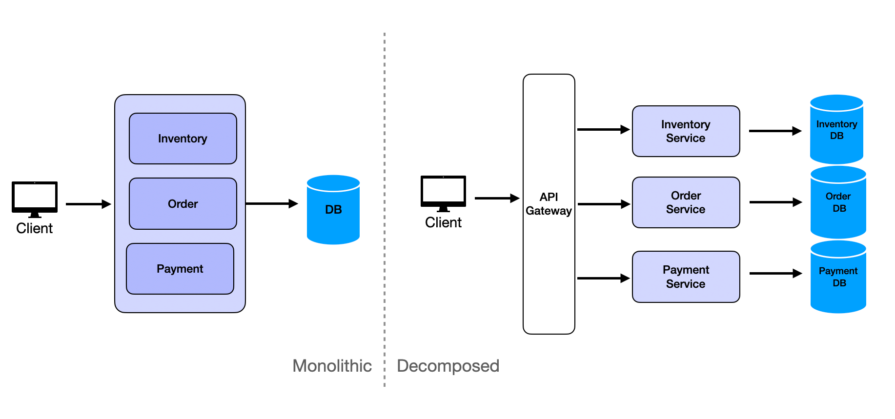
Scalability – Types
“Scalability is not a feature. It is a design mindset.”

Slide 41
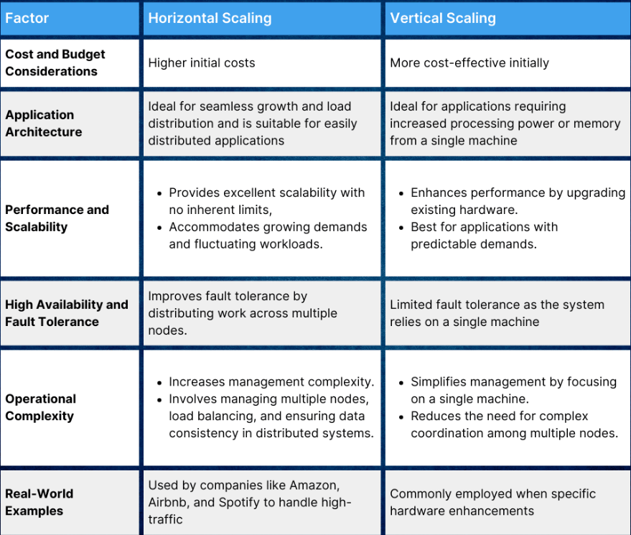
Scalability – Types

Slide 42
Which Scaling Technique is Preferred ?
Scenario | Best Choice for Scaling
Small Systems | Vertical
High Traffic | Horizontal
High Availability | Horizontal
Cloud Systems | Horizontal
Scaling is Required When:
Latency increases
Throughput decreases
Errors increase

Slide 43
System Design - Applications
System Design concepts are widely applied in real-world software systems to ensure scalability, performance, and reliability. The following applications demonstrate how system design principles are used in practice:
1. Web Applications
System design is used to design scalable web applications such as e-commerce websites, learning management systems, and social media platforms. Concepts like load balancing, caching, and modular architecture help these applications handle thousands or millions of users simultaneously.
2. Mobile Applications
Large mobile applications like food delivery, ride-sharing, and banking apps rely on system design to manage backend services, APIs, databases, and real-time notifications while maintaining low latency and high availability.
3. Enterprise Software Systems
Organizations use system design to build enterprise systems such as ERP, CRM, and payroll management systems. Proper system design ensures data consistency, security, fault tolerance, and smooth integration between multiple modules.

Slide 44
System Design - Applications
4. Cloud-Based Systems
System design plays a crucial role in cloud platforms by enabling auto-scaling, high availability, disaster recovery, and efficient resource utilization. Applications hosted on cloud environments depend heavily on good architectural design.
5. Distributed Systems
System design is essential for distributed systems where components run on multiple machines. It helps in managing communication, data sharing, fault tolerance, and performance across distributed services.
6. Real-Time Systems
Applications such as online gaming, stock trading platforms, and live streaming systems use system design principles to achieve low latency, high throughput, and continuous availability.
System design concepts are not limited to interviews—they are applied in almost every large-scale software system used in daily life.

Slide 45
Thank You for your Patience
In case of any queries, feel free to ping..!

